Slide 1

MRA Project ML 1
Samiullah SYED
PGPDSBA.O.FEB.C2021
net2sam@gmail.com

Slide 2
Agenda [Table OF CONTENT]
Executive Summary of the data
EDA and Inference
Customer Segmentation using RFM analysis
Inferences from RFM Analysis and identified segments

Slide 3
PROBLEM STATEMENT
An automobile parts manufacturing company has collected data of transactions for 3 years. They do not have any in-house data science team; thus, they have hired you as their consultant. Your job is to use your magical data science skills to provide them with suitable insights about their data and their customers.
Auto Sales Data: Sales_Data.xlsx

Slide 4
About data
The data provided is from an Auto parts manufacturing company
The data has 20 variables and 2747 records.
Number of variables: 7 – Numeric Variables, 1 – datetime, 12 – Categorical Variables
The company currently has 89 Customers from 19 countries across the globe
They are dealing 109 products in 7 different product lines
The data is clean and has neither null values nor duplicate records

Slide 5
Executive SUMMARY [NON MANDATORY]
This analysis is being carried out in order to gain insights about the company’s performance over the years
Prospects of improvement
Customer analysis, and RFM based segmentation
Identifying patterns and other analytical inferences to derive business solutions

Slide 6
EDA (Data overview)
Shape of data: (2747, 20)
Continuous variables: 7
Categorical variables: 12
Date-Time variables: 1
Null values: 0
Duplicate records: 0

Slide 7

Tools Used - Python & Tableau
• EDA for the dataset is performed using Python
• Libraries used:
Pandas
Numpy
Seaborn
Matplotlib
EDA – Bi-variate Analysis is done in Tableau tool – with the workflow published in Tableau public:
Samiullah Syed - MRA Project ML 1| Tableau Public

Slide 8
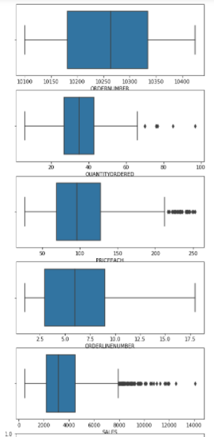
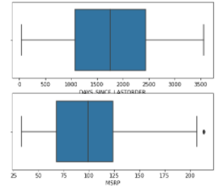
OUTLIER DETECTION
1. The data shows varied range of entries across each variables
2. More number of outliers observed in Sales variable

Slide 9

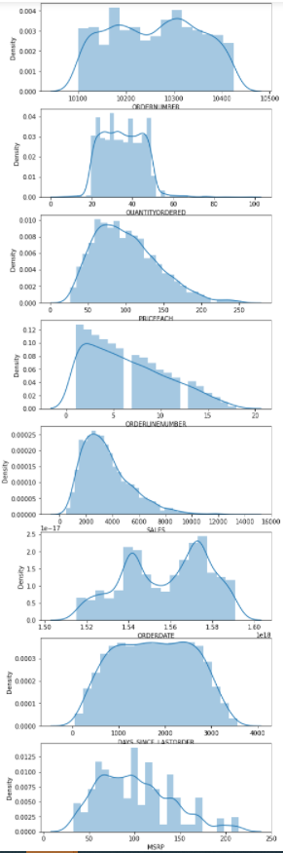
UNIVARIATE ANALYSIS (DIST PLOT)

Slide 10
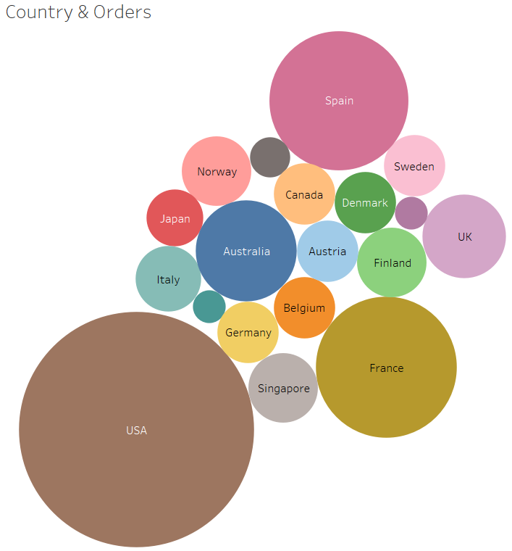
BIVARIATE ANALYSIS
Countries that have highest orders are USA, followed by Spain and France.
Ireland and Philippines are the least consuming countries.
The rest of the countries as per order as shown in size corresponding to order counts.

Slide 11
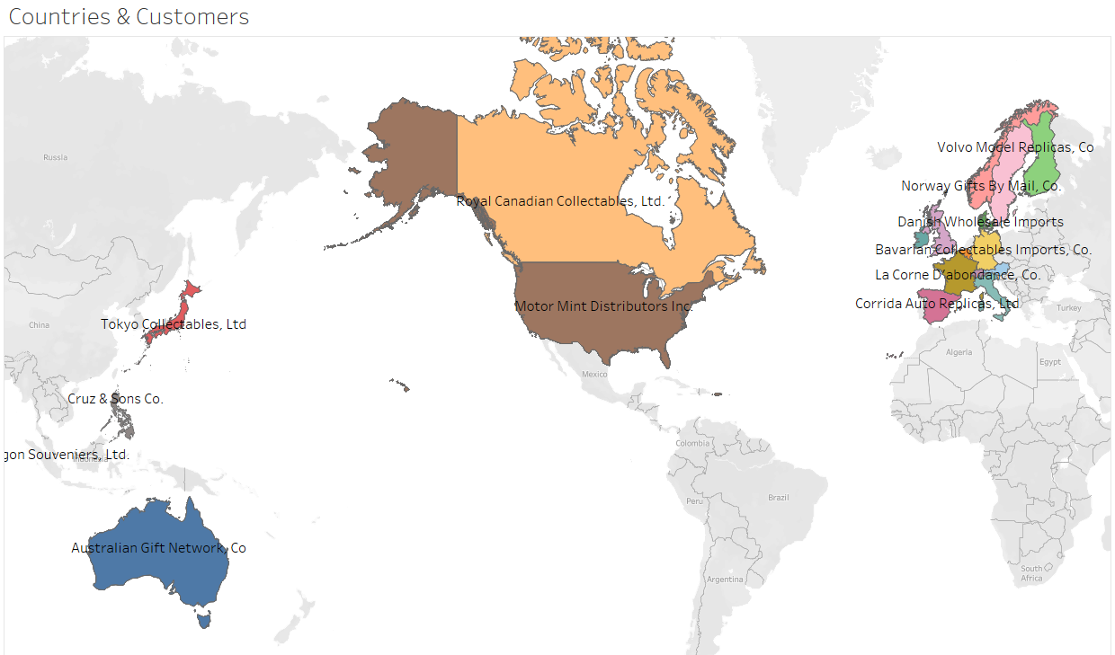
BIVARIATE ANALYSIS
Customers and order origin Country is
as shown :

Slide 12
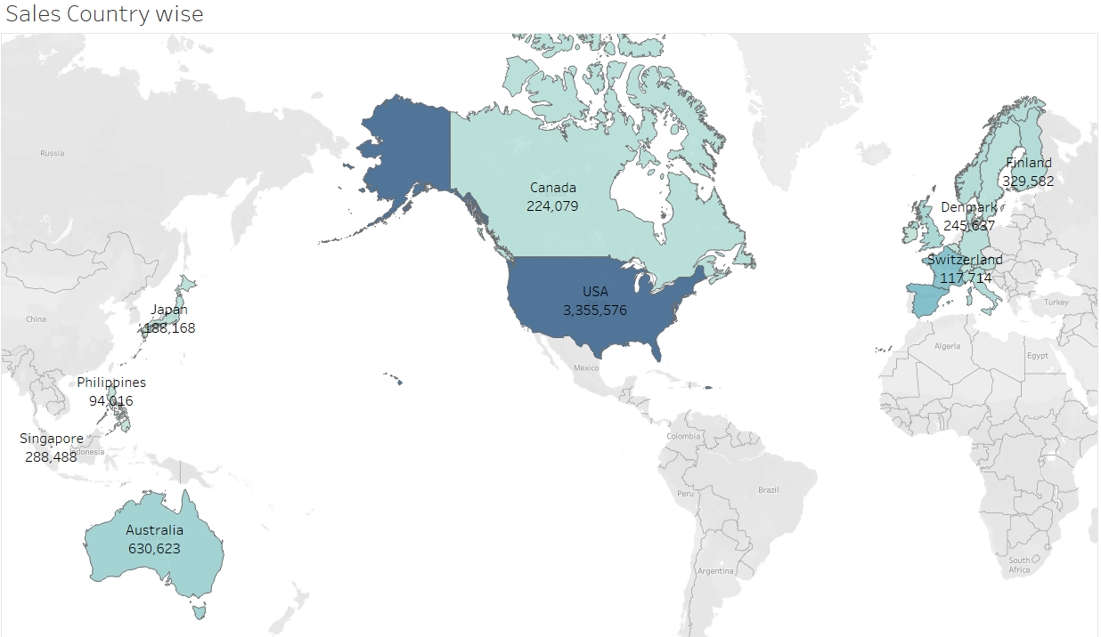
BIVARIATE ANALYSIS
1. Company is having a viable market in almost 19 countries
2. This graph shows the sales across different countries
3. USA is the primary market of the company contributing maximum to its turn-over
4. Some European countries like Spain and Switzerland shows good number of sales following USA

Slide 13
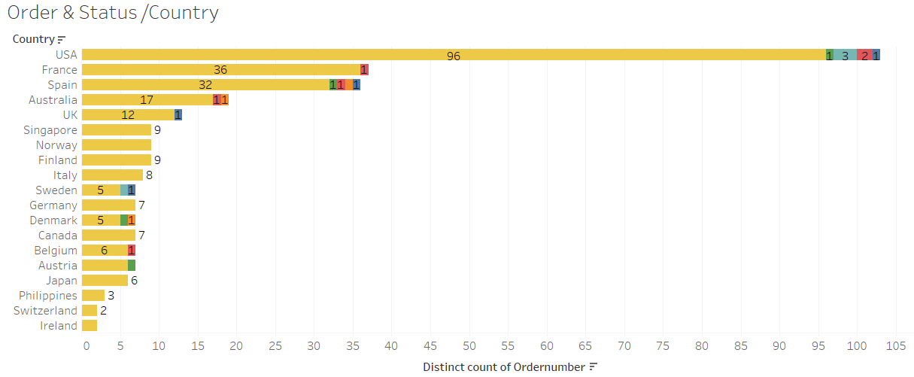
BIVARIATE ANALYSIS
USA is having most orders shipped and high sales with 3 on hold and 1 cancelled.
This is followed by France, and so on order of decreasing sales.

Slide 14
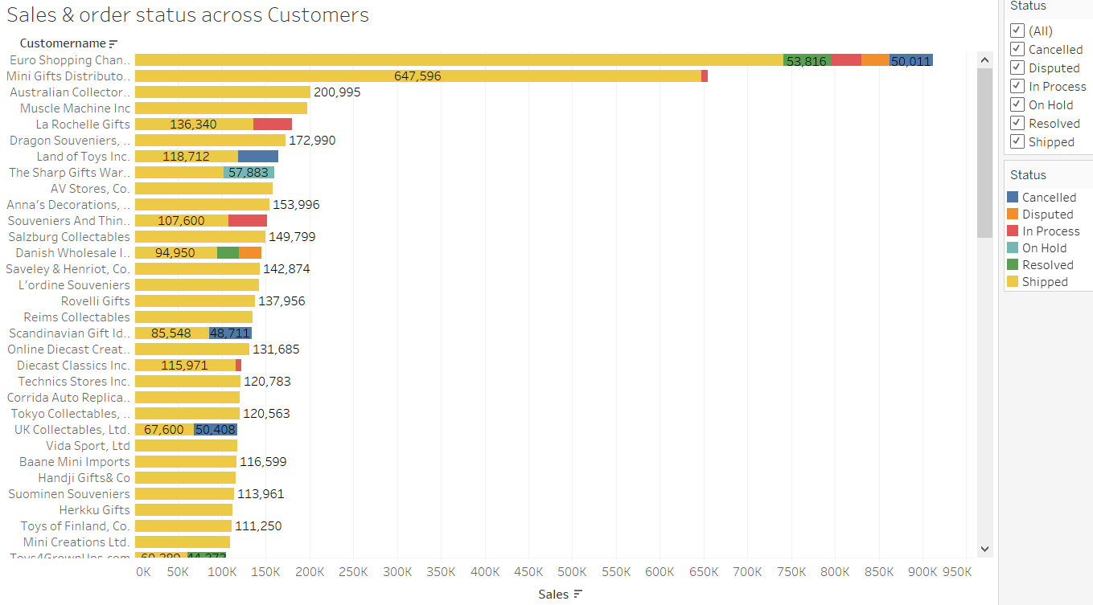
BIVARIATE ANALYSIS
‘Euro Shopping channel’ is the customer having highest sales and orders shipped followed by ‘Mini Gifts Distributers ltd’.
‘Euro Shopping Channel’ is also having orders in cancelled, Disputed status – again an inference for company to check

Slide 15
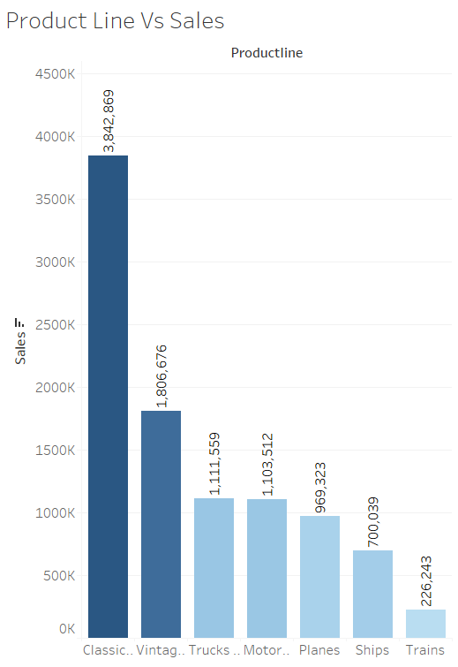
BIVARIATE ANALYSIS
‘Classic cars’ are visibly the most selling product line followed by ‘Vintage cars’ and so on..
Further analysis should be done to analyze patterns

Slide 16
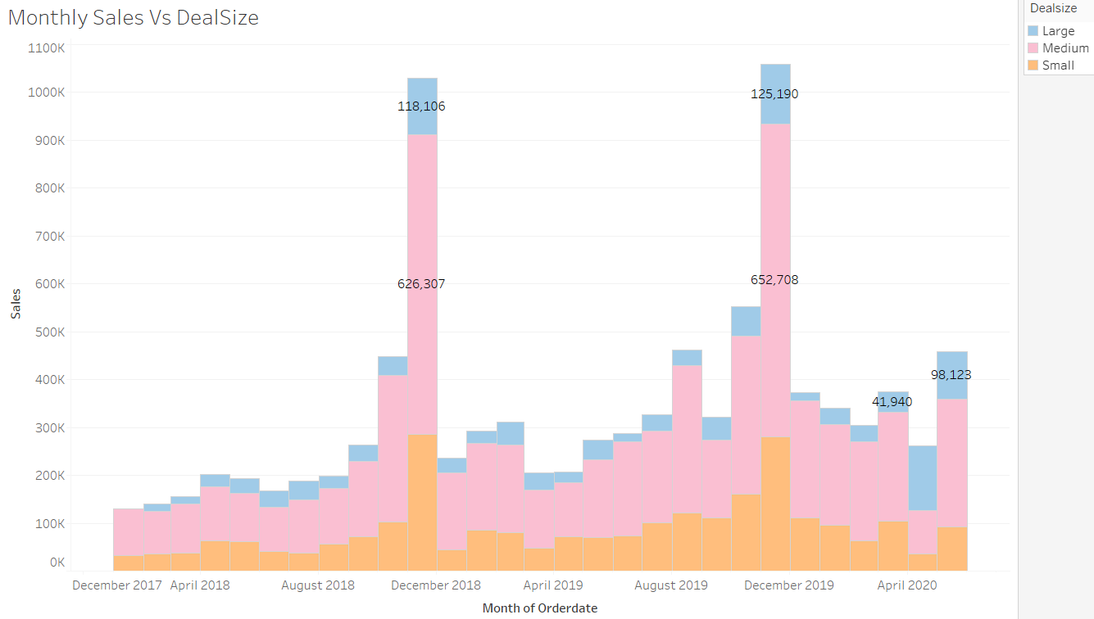
BIVARIATE ANALYSIS
It’s observed that the month November has increased sales across the years and increasing Year-on-Year for all sort of ‘Dealsize’ – Large/Medium/Small
Further analysis helps to understand the Segments, Product lines and patterns

Slide 17
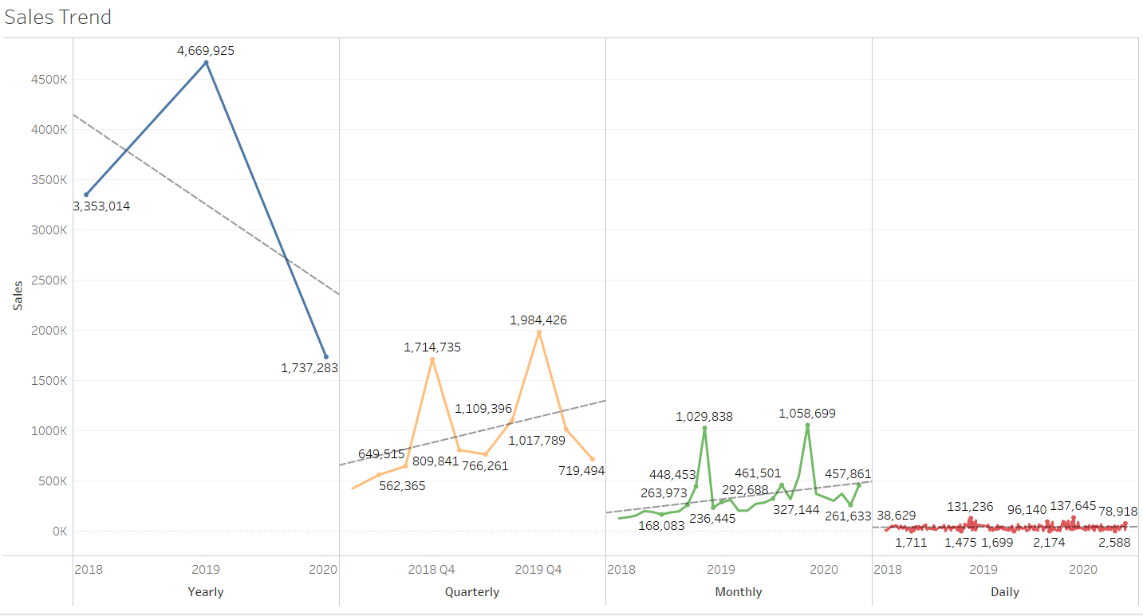
Sales trend
Sales trend per different time period:
1) Yearly trend in sales decreasing in 2020 from
2018 with 2019 having highest sales.
2) Quarterly & Monthly sales having increasing
trend with seasonality –
indicating sales increases in Q4

Slide 18
Summary
USA is the primary market
Classic cars is the most selling product line among the 7 different product lines
There is a recurring pattern observed in sales, November month is when the highest sales is happening over the past three years
Euro shopping channel is the most loyal customer

Slide 19
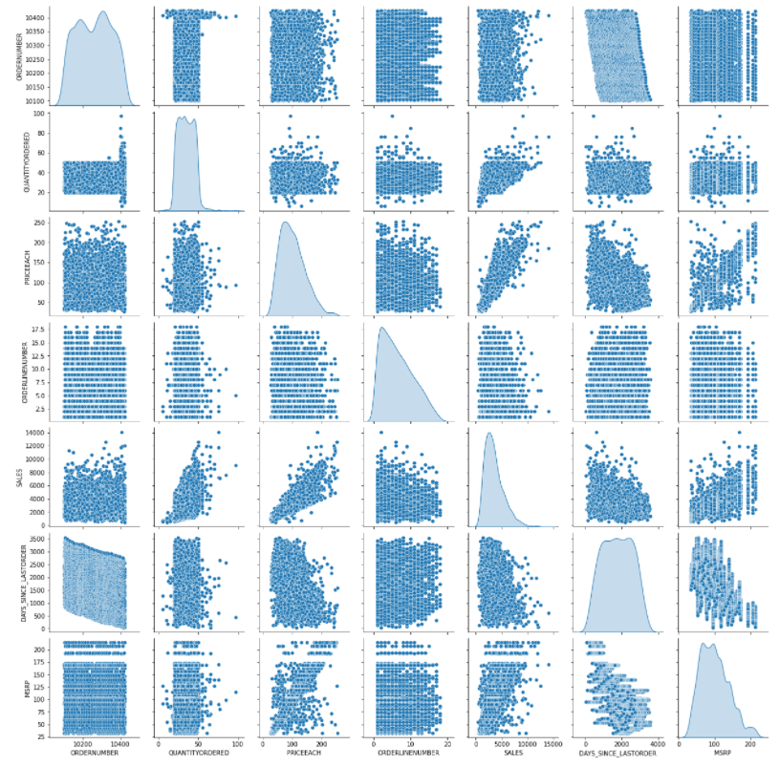
PAIR PLOT
1. The pair plot shows the data in most variables are normally distributed
2. There’s visible correlation between Quantity Ordered, Sales, MSRP and PriceEach.
3. Other variables don’t show any signs of correlation

Slide 20
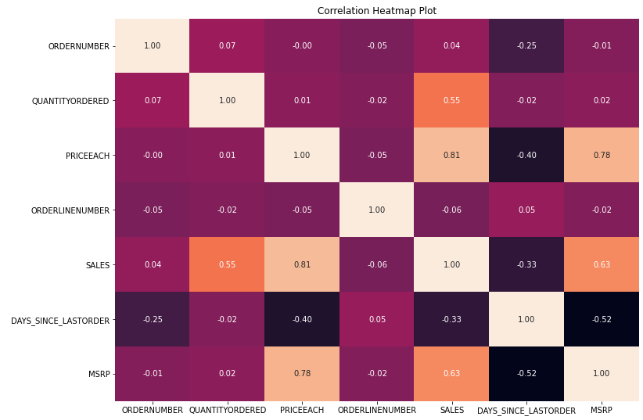
HEATMAP
1. The heatmap provides affirmation to our observation in pair plot.
2. Sales variables is highly correlating with MSRP and PRICEEACH
3.There is also a partial correlation observed between QuantityOrdered and Sales

Slide 21
Eda SUMMARY [INFERENCES]
USA, Spain and France are the main market for the company
Most gold customers are present in USA market
Euro shopping channel present in Spain is the most loyal customer followed by Mini Gifts Distributor in USA
Ireland, Philippines and Belgium are performing very low in terms of sales
La Rovelli Gifts, one of the high sale customer hasn’t made any purchases recently. Take actions to retain them.
Switzerland only deals in Classic cars product line.
Classic cars product line is the highest selling.
Trains product line is the least selling
Sales of large size deal almost remain stagnant over the years, and it can be presumed that company should focus on getting large size chunk projects.

Slide 22
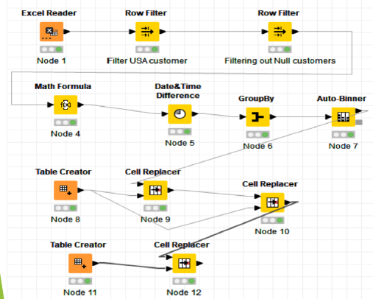
RFM analysis using KNIME

Slide 23

RFM Segmentation
R : Recency – is the most recent customer order which is calculated taking difference of Order date & current date in Days.
RECENCY in Days = ORDERDATE – Current Date
F : Frequency – is the how often the orders are placed by customers, from the excel sheet the variable DAYS_SINCE_LASTORDER.
M : Monetory – Sales can be used as Monetory but in this project used the calculation of price & Quantity:
Monetory = QUANTITYORDERED * PRICEEACH
Assumption 1 – All the prices & sales figure are in same currency.
Assumption 2 – Sales & (Quantity * Price) may or may not be same.
Using KNIME for generating RFM figures & Bins accordingly.
Created 3 Bins each for R, F & M with below distribution of values:
The final output will have addition values:
Recency
Monetory
Recency Bins (Values - L, M, H)
Monetory Bins (Values - L, M, H)
Frequency Bins (Values - L, M, H)

Slide 24
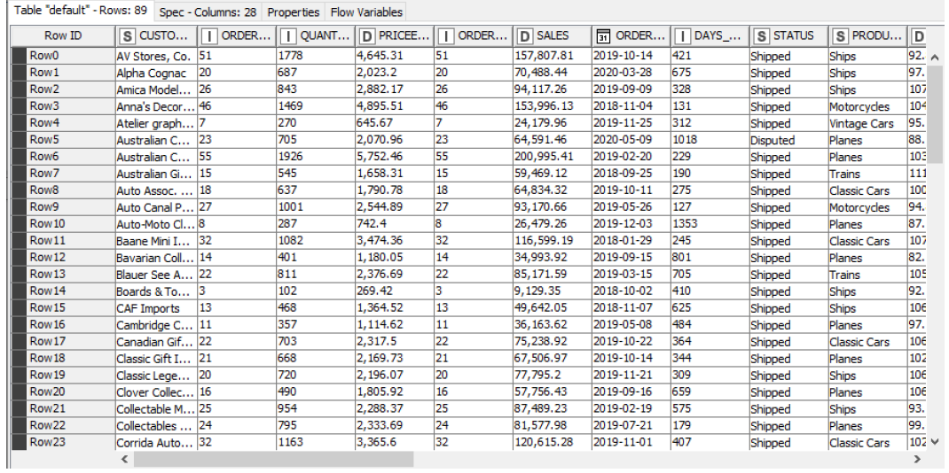
RFM Analysis
The output excel file from KNIME RFM segments is used in Pivot to get actual RFM scores on sales:

Slide 25
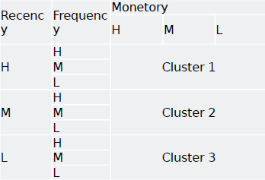
RFM Analysis Cluster 1 : Very Active customers with high orders & Sales values. Cluster 2 : At risk customers with good orders & Sales values. Cluster 3 : Lost customers which could have provided high revenues with one-time orders.

Slide 26
RFM Inferences
Who are your best customers? | Which customers are on the verge of churning ? | Who are your lost customers? | Who are your loyal customers?
Euro Shopping Channel Mini Gifts Distributors Ltd. Australian Collectors, Co. Muscle Machine Inc Dragon Souveniers, Ltd. | Land of Toys Inc. AV Stores, Co. La Rovelli Gifts Online Diecast Creations Co. Corrida Auto Replicas, Ltd | CAF Imports West Coast Collectables Co. Cambridge Collectables Co. Double Decker Gift Stores, Ltd Bavarian Collectables Imports, Co. | Euro Shopping Channel Mini Gifts Distributors Ltd. La Rochelle Gifts The Sharp Gifts Warehouse Souveniers And Things Co.
List of top 5 best customers :
At-Risk customers bring in most monetary benefits – but haven’t purchased recently.
Most of the customers belong to cluster 2 – this also means there is huge potential of this segment may switch to another supplier.
Cluster 1 – Active and loyal customers bringing fairly good revenue.
Cluster 2 is the segment – the company can target to give more services to bring in loyalty as they amount to a goof revenue.
Maximum loyal customers belong to countries USA & France.
USA is also having most at risk customers, followed by France, Australia and Finland. If shipping issues could be handled better for these countries, it would be better for business.

